Slide 1
Random Password Generator
Title: RANDOM PASSWORD GENERATOR Name: Shaik. Mubeen Ahmed Organization: Micro IT

Slide 2
Introduction
The Random Password Generator is a C++ program designed to create strong, secure passwords based on user-defined preferences. It allows users to choose the desired length and whether to include uppercase letters, lowercase letters, digits, and special characters. By utilizing built-in libraries like <cstdlib> and <ctime>, the program generates unpredictable and complex passwords, helping users enhance their online security. This project showcases the practical application of conditional logic, string manipulation, and random number generation in C++.

Slide 3
OBJECTIVES OF THE PROJECT
To build a secure password generator in C++.
To allow users to select character sets dynamically.
To use random number generation (rand(), srand()).
To improve understanding of C++ strings and control structures.

Slide 4
WHAT IS A RANDOM PASSWORD GENERATOR?
A Random Password Generator is a program that creates a password containing a mix of:
Uppercase letters (A-Z)
Lowercase letters (a-z)
Digits (0-9)
Special characters (!, @, #, etc.) It ensures that passwords are hard to guess and secure for use.

Slide 5
FEATURES OF THE PROGRAM
User-defined password length.
User-controlled inclusion of:
Uppercase letters
Lowercase letters
Digits
Special characters
Real-time password generation.

Slide 6
C++ CONCEPTS USED
#include <string> for password construction
#include <ctime> and srand(time(0)) for randomness
rand() % n for random indexing
Conditional logic for character set inclusion
Modular function: generatePassword()

Slide 7
CODE SNIPPET (Part 1)
#include <iostream>
#include <string>
#include <cstdlib>
#include <ctime>
using namespace std;
string generatePassword(int length, bool useUpper, bool useLower,
bool useDigits, bool useSpecial) {
string upper = "ABCDEFGHIJKLMNOPQRSTUVWXYZ";
string lower = "abcdefghijklmnopqrstuvwxyz";
string digits = "0123456789";
string special = "!@#$%^&*()-_=+[{]}|;:',<.>/?`~";

Slide 8
CODE SNIPPET (Part 2)
string allChars = "";
if (useUpper) allChars += upper;
if (useLower) allChars += lower;
if (useDigits) allChars += digits;
if (useSpecial) allChars += special;
string password = "";
for (int i = 0; i < length; ++i) {
int randIndex = rand() % allChars.size();
password += allChars[randIndex];
}
return password;
}

Slide 9
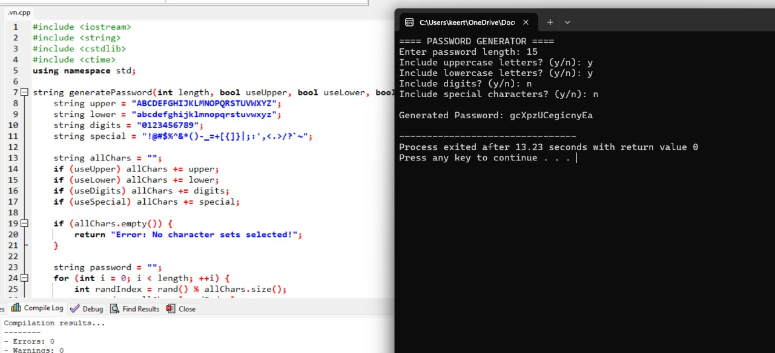
OUTPUT SCREENSHOT

Slide 10
TOOLS USED
Dev C++ (IDE)
C++ Standard Libraries: <iostream>, <string>, <ctime>, <cstdlib>

Slide 11
KEY LEARNINGS
Mastered random number generation in C++
Learned modular programming with functions
Improved string handling and conditional logic
Built a useful tool for real-life password security

Slide 12
CONCLUSION
This project on Random Password Generation helped me apply key C++ programming concepts such as functions, loops, conditionals, and randomization to build a practical and secure tool. It improved my understanding of user interaction, character handling, and logic building. Overall, the project not only strengthened my coding skills but also demonstrated how C++ can be used to develop real-world applications that enhance digital security.

Slide 13


